Slide 1
Supporting students with their menstrual cycle at school
September, 2025

Slide 2
Agenda
Rationale of the session
Education in school
Education at home
Support in school
Period Poverty
Lesson approach
Your support
Contacting us with concerns
Feedback

Slide 3
Rationale
We know that the menstrual cycle can have a huge impact on our female students
  A child’s first period
    Anxiety/stress/worry
    Pain/cramps
  All periods
    Anxiety/stress/worry
    Physical effects (pain/cramps)
    Emotional effects (hormones/mood)
    Other complications (PCOS)
Notes:
GWK

Slide 4
Rationale
Attendance impact (2024/25)
 | Boys | Girls | Difference
National | 91.7% | 90.9% | 0.8%
BHCS | 93.6% | 91.5% | 2.1%
Girls attend less than boys
Notes:
National research being given to schools via the LA, suggests one possible causes of the difference in attendance is the lack of support for girls in schools during their menstrual cycle AND parents not always knowing what the school can do to help.

Slide 5
Rationale
Attendance impact
 | BHCS (2023/24) | BHCS (2024/25) | Difference
Year 7 | 95.4% | 94.4% | n/a
Year 8 | 90% | 93.7% | 1.7%
Year 9 | 89.9% | 89.7% | 0.3%
Year 10 | 89.2% | 89.2% | 0.7%
Year 11 | 86.8% | 89.2% | 0%
The biggest ‘drop off’ in attendance, is from girls moving from Yr7 to Yr8
Notes:
The biggest decline happens between Yr7 and 8 – which is possibly linked to the first period that a female may experience.

Slide 6
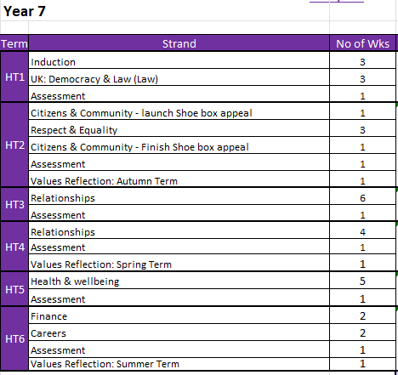
Education in school
MyWorld – tutor programme
Health and Well-Being topics include:
  Mental health
  Healthy living
    Diet
    Exercise
  Puberty
  Menstruation
  Menopause
Notes:
And in science curriculum – the hormone changes, etc.

Slide 7

Education in school
Assemblies – Equality and Rights Advocates
Notes:
GWK

Slide 8
Education at home
Periods have always been a sensitive topic to discuss, sometimes, even taboo. It is important that we educate our young people and to speak openly about periods, especially at home.
How can I approach this topic with my child:
  Be sensitive
  Normalise periods
  Have open dialogue
  Encourage curiosity/questions
Useful websites:
Hey Girls: Period Education For Parents & Carers | Learn | Hey Girls
The Period Place: theperiodplace.co.uk
NHS: Periods - NHS
Notes:
FJD

Slide 9
Support in school
At BHCS, we are committed to providing our students with free sanitary products, to support with their cycle at school.
What do we have?
  Sanitary towels
  Tampons
  Spare underwear/tights
  Heat pads
Where are these things?
  Toilets
  Well-Being Centre (WBC)
  Medical Room
Who could your child talk to if concerned, or can’t find the products/doesn’t know how to use the products?
Mrs Mallin – Medical Room
WBC team
Tutor
EARAs
Notes:
FJD

Slide 10

Support in school
Notes:
FJD

Slide 11
Period Poverty
What is period poverty?
Period poverty is defined as the lack of access to menstrual products and safe/hygienic spaces to use them. This issue affects an estimated of 500 million people globally.
If you feel that you are affected by period poverty, please contact:
Miss Jawad – fjawad@bhcs.sfet.org.uk
If you want to see whether you qualify for FSM, follow this link: https://www.hants.gov.uk/educationandlearning/freeschoolmeals/juniorsecondary
Notes:
FJD

Slide 12
Lesson approach
Our stance on toilet breaks during lessons…
  Students need to be in lessons
    Toilets should be used at break/lunch time
    Therefore, the usual response to “can I go to the toilet” during lesson is “no”.
  However;
  If it is urgent, the teacher will allow the student to go
      We don’t want an accident!
  If your child needs to go as a result of her period
      We WILL let her go
      We just need to know
        Encourage your child to talk to the teacher
        Parents can email the tutor/teachers
        Parents can email us on wellbeing@bhcs.sfet.org.uk
Notes:
GWK

Slide 13


Lesson approach
Our stance on toilet breaks during lessons…
“My daughter is too afraid to ask a teacher to go to the toilet during classes”
Notes:
GWK

Slide 14

Your support
Please discuss with your child, the need for:
Honesty re: toilet need
Sensible use of products
Hygienic disposal of products
Maturity – remember teachers are adults and here to support
Resilience - not letting their menstrual cycle impact their education/miss school
Talking to us – we are here to help and support
Notes:
GWK

Slide 15
Contacting us
If you have a concern regarding your child's period, please get in touch with:
Your child's Tutor
Your child's Head of Year
The WBC team at wellbeing@bhcs.sfet.org.uk
Notes:
FJD

Slide 16
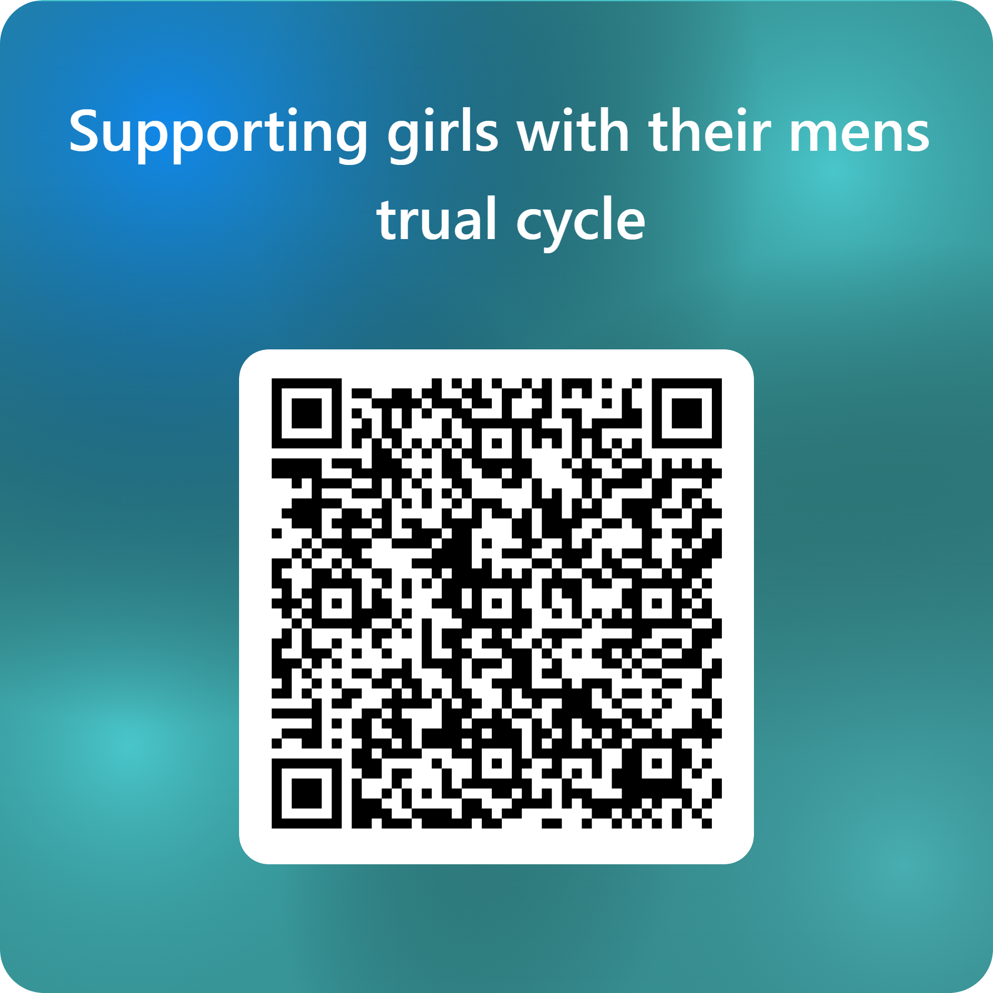
Contacting us
Notes:
FJD

Slide 17
Brighton Hill Community School
Brighton Way
Basingstoke
Hampshire
RG22 4HS
Phone: 01256 350606
Email: admin@brightonhill.hants.sch.uk

