Slide 1

CEIAG Update 1 (06.12.23)
BHCS Committed to Securing the Quality in Careers Standard
SIP>FIP Continuing to support the BHCS Careers Programme

Slide 2



Quality in Careers Standard

Slide 3

BHCS are committed to securing the award this academic year
Once secured the award is valid for 3 years.

Slide 4
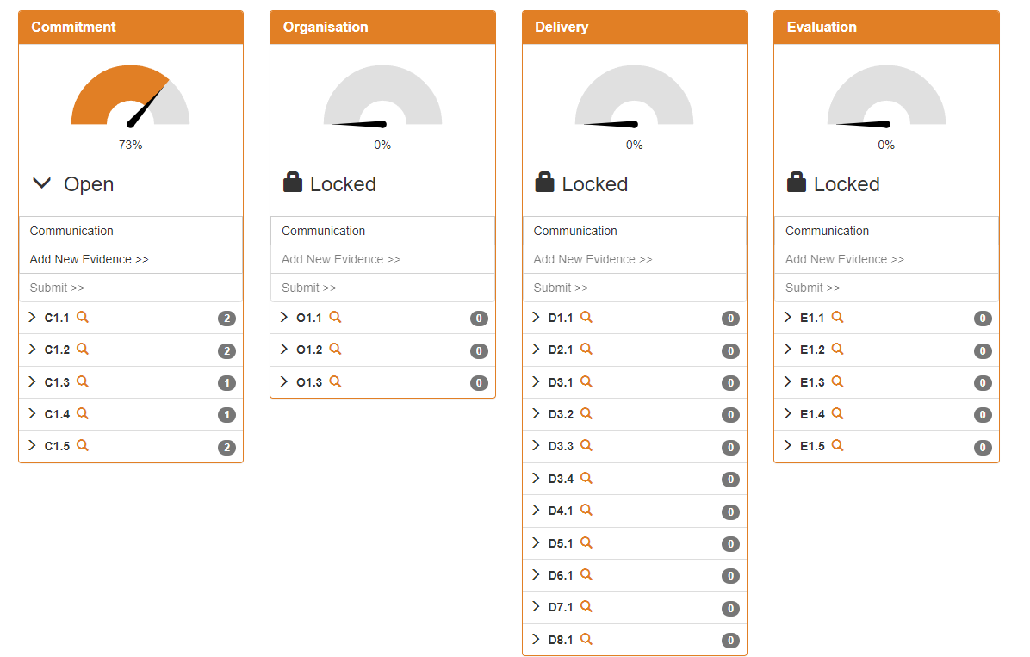
Quality in Careers Criteria

Slide 5
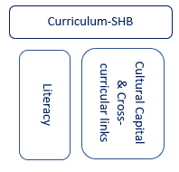
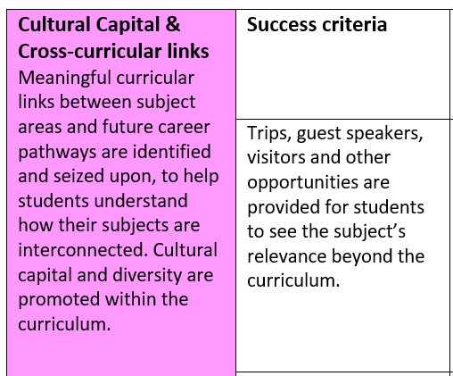
SIP>FIP 2023.24: Continuing to support careers

Slide 6
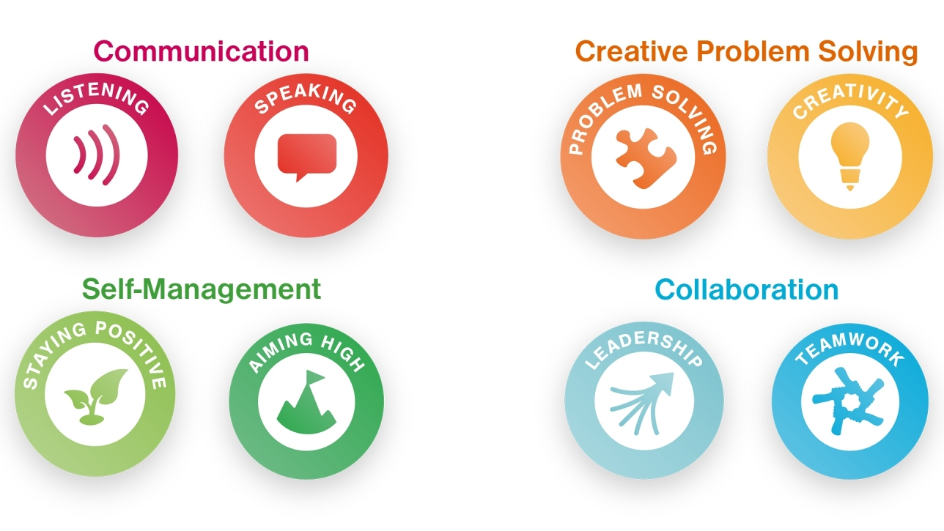
Employability Skills Amplification
Located
Here!
Employability Skills Logos

Slide 7
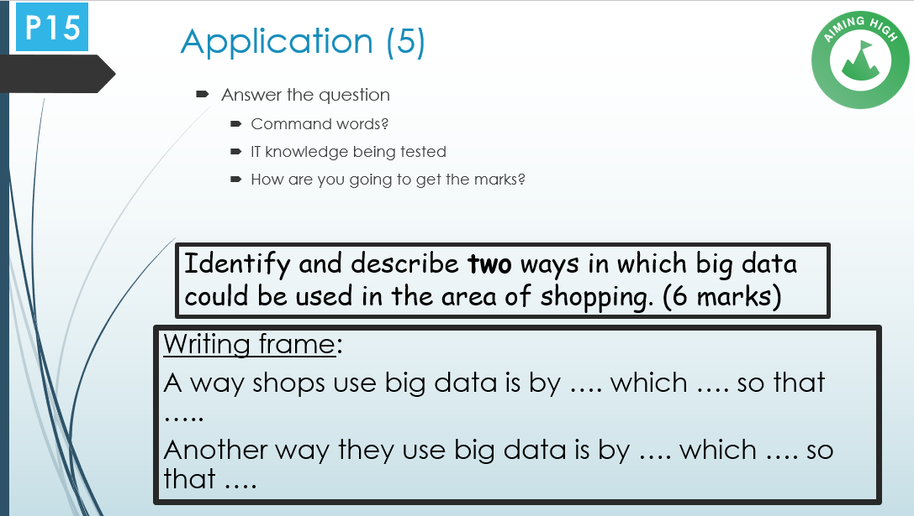
Employability Skills Amplification
Please Save
Here!
Lesson Exemplars

Slide 8
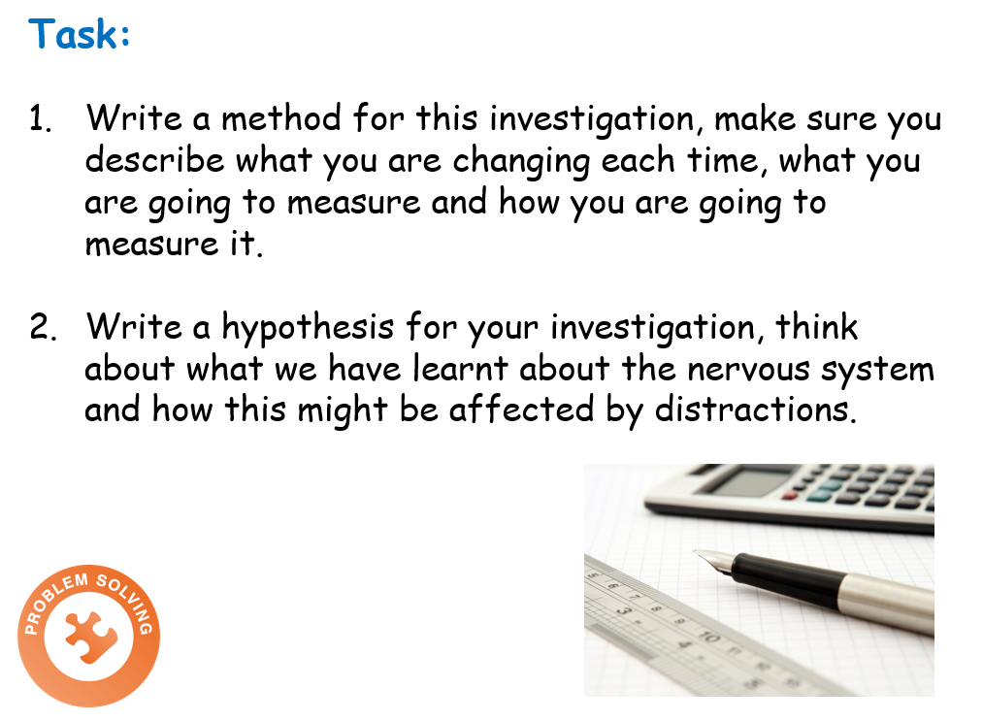

Employability Skills Amplification
Lesson Exemplars

Slide 9






Employability Skills
Project work where roles are provided.
Expert in the room opportunities/supporting peers
D.I.R.T. by reframing incorrect answers as now ‘knowing what you don’t know’
Oracy phases of lessons
Employability Skills Logos
Lesson Exemplars

Slide 10
Employability Skills
BHCS Careers Programme
Mr Watkins – Deputy Head & Careers Lead

