Slide 1

CEIAG: Unifrog Year Group Tutor Programme
Careers Education Information Advice & Guidance

Slide 2
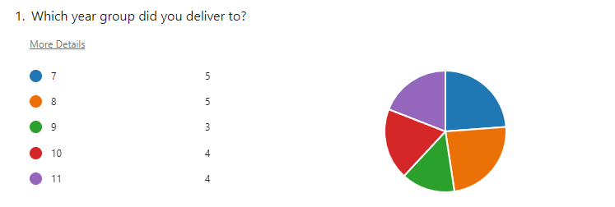
2021.22 Tutor Feedback

Slide 3
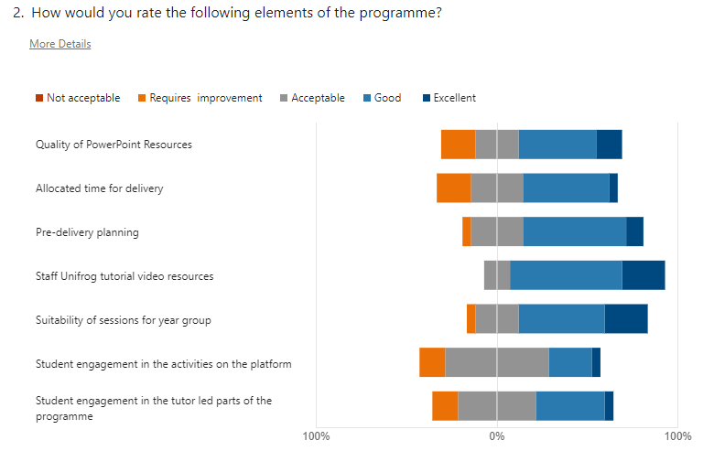
2021.22 Tutor Feedback

Slide 4
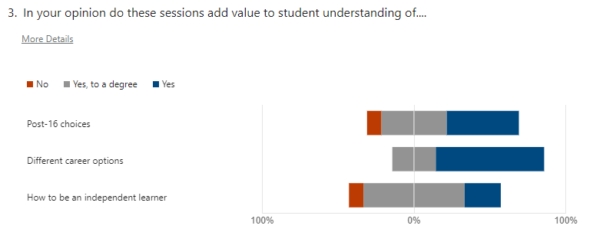
2021.22 Tutor Feedback

Slide 5
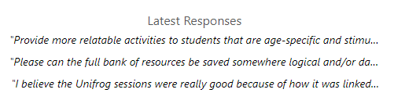
Response to feedback
Key responses
All resources will be saved here (Teacher Share > Tutor Groups > Tutor Programme 2022-23 > Unifrog Year Group Programmes) in respective year group folders.
All resources will be reviewed and ‘trimmed’ to be fit for delivery in a 20 min (AM) or 30 min (PM) tutor session
Year 11 sessions to be moved to HT1 delivery in advance of students making their applications
A BHCS Work Experience rationale is being developed. NB this is different to the Gatsby Benchmark commitment of Experience of a Workplace
Target year group delivery of programme across a single week, likely best delivered A side in week 1 then B side week 2 due to IT rooming challenges where the AM session is a set up for the PC based PM session.

Slide 6
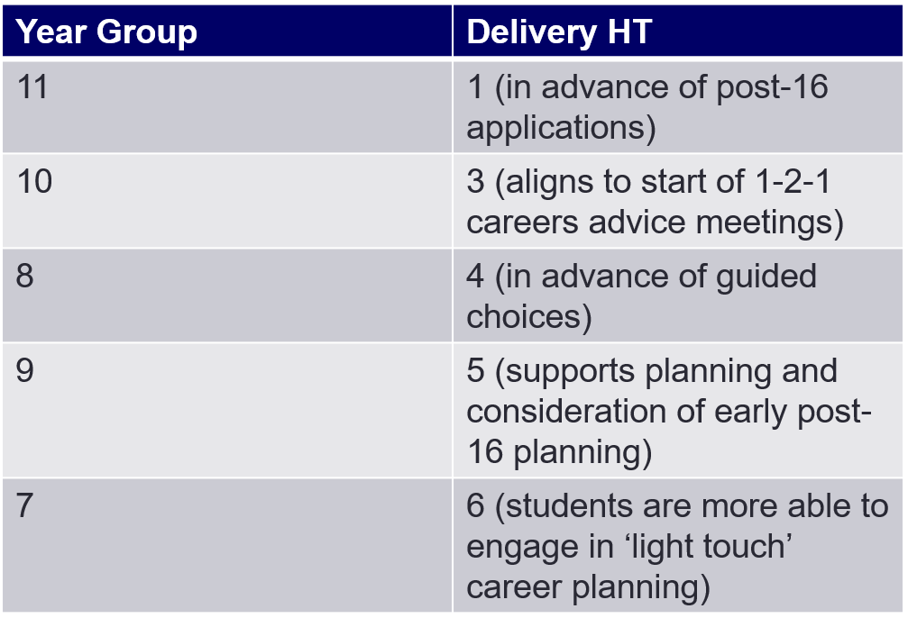
Delivery Schedule

Slide 7
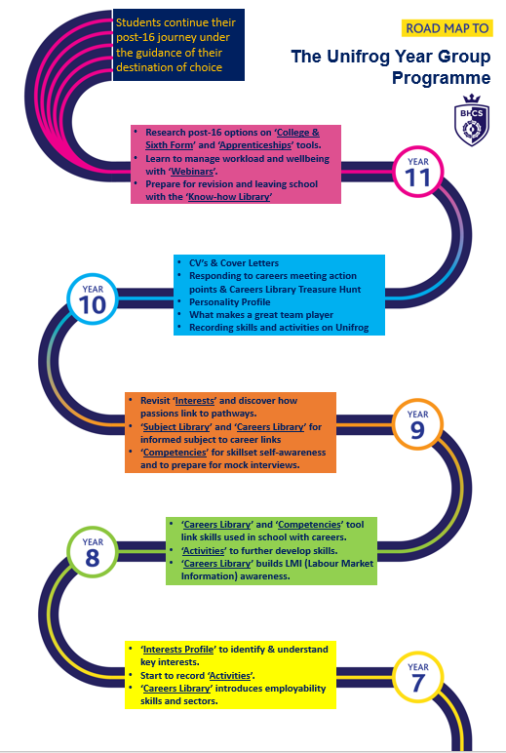
Delivery Schedule

Slide 8
Tutorial to refresh or introduce
Logging in, accessing student view, basic orientation and student locker
How to check student activity on Unifrog
How to review a named student’s ‘footprint’ careers advice action plan document
How to add a document to a student locker (recorded last academic year)

Slide 9
Brighton Hill Community School
Brighton Way
Basingstoke
Hampshire
RG22 4HS
Phone: 01256 350606
Email: admin@brightonhill.hants.sch.uk

